Slide 1
Compilers
Introduction

Slide 2
Agenda
Course Information
Why Study Compilers?
The Structure of a Compiler.

Slide 3
Instructors
Lectures:
Dr. Shimaa Ibrahim Hassan
Time: Monday & Wednesday @ 10:30
shaimaa.rizk@feng.bu.edu.eg
shimaahassan4779@gmail.com
Shimaa_4779@yahoo.com
Sections:
Eng: Soha Emad
Time: Wednesday @ 12:30

Slide 4
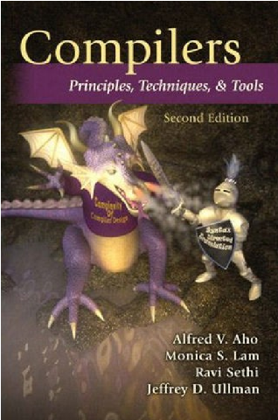
Main Book

Slide 5
Grading system
Final exam ................................. 90 degrees
Mid-term .................................. 20 degrees
Section ....................................... 10 degrees
Quizes ......................................... 5 degrees
Project ........................................ 25 degrees

Slide 6
Why Study Compilers?
Learn how to build programming languages.
Learn how programming languages work.
Learn tradeoffs in language design.
Build a large software system.

Slide 7
From Description to Implementation
Lexical analysis: Identify logical pieces of description.
Syntax analysis: Identify how those pieces relate to each other.
Semantic analysis: Identify the meaning of those relations.
IR Generation: Generate an intermediate code (three address code).
IR Optimization: Simplify the intermediate code.
Code Generation: Generate the assembly code.
Optimization: Improve the resulting assembly.

Slide 8
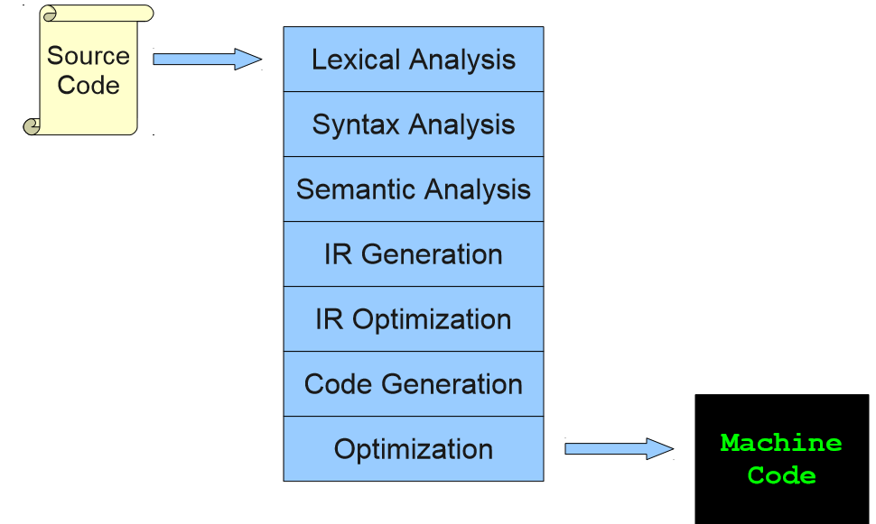
The Structure of a Modern Compiler

Slide 9
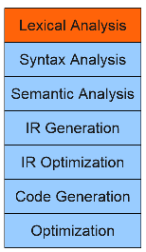
Lexical Analysis
while (y < z) {
int x = a + b;
y += x; }

Slide 10
Lexemes vs Tokens
Input Stream:
while (y < z) {
int x = a + b;
y += x; }
Token Stream:
T_While T_LeftParen T_Identifier y T_Less T_Identifier z T_RightParen T_OpenBrace T_Int T_Identifier x T_Assign T_Identifier a T_Plus T_Identifier b T_Semicolon T_Identifier y T_PlusAssign T_Identifier x T_Semicolon T_CloseBrace

Slide 11
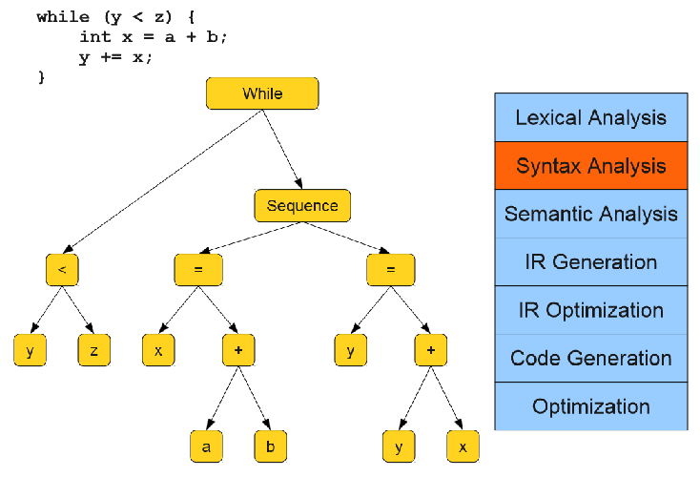
Syntax Analysis
Parse Tree:

Slide 12
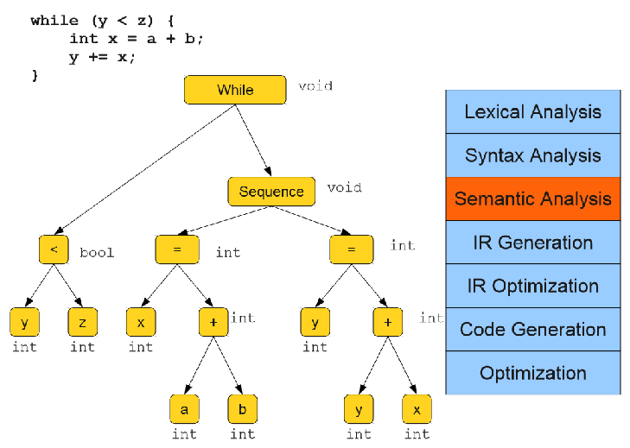
Semantic Analysis

Slide 13
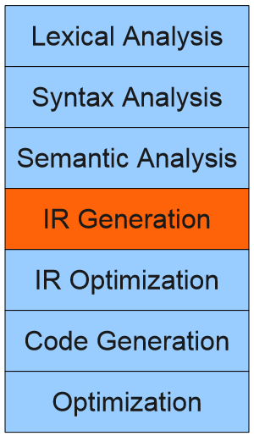
IR Generation
while (y < z) {
int x = a + b;
y += x; }
Loop: x = a + b
y = x + y
_t1 = y < z
if _t1 goto Loop

Slide 14
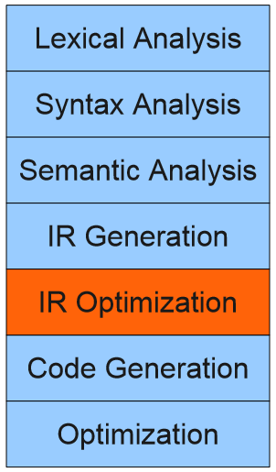
IR Optimization
while (y < z) {
int x = a + b;
y += x; }
x = a + b
Loop: y = x + y
_t1 = y < z
if _t1 goto Loop

Slide 15
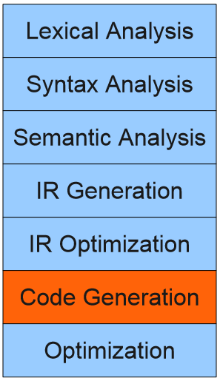
Code Generaion
while (y < z) {
int x = a + b;
y += x; }
add $1, $2, $3
Loop: add $4, $1, $4
slt $6, $1, $5
beq $6, $zero, loop

Slide 16
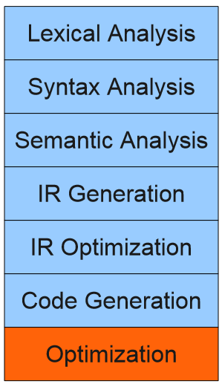
Optimization
while (y < z) {
int x = a + b;
y += x; }
add $1, $2, $3
Loop: add $4, $1, $4
blt $1, $5, loop

